Slide 1
FIFA World Cup 2022 Analysis

Slide 2
Agenda
Introduction
Deliverables
Analysis
Dashboard

Slide 3
Introduction
The FIFA World Cup is the biggest event in global sports, bringing together the best teams and players from around the world.
In 2022, the tournament took place in Qatar, marking the first time it was held in the Middle East.
Our presentation will provide a detailed analysis of the teams and trends to watch in this highly anticipated tournament, based on the FIFA World Cup 2022 Complete Dataset available on Kaggle.

Slide 4
Deliverables (1/2)
In our analysis of the FIFA World Cup 2022 Complete Dataset, we will focus on the following key metrics:
Average Possession by Top 10 Teams: We will calculate the average possession for the top 10 teams in the tournament, providing insights into which teams have the strongest ball control and ability to dominate the field.
Most Fouls Committed by Top 10 Teams: We will analyze the number of fouls committed by the top 10 teams, identifying which teams tend to be more aggressive in their playstyle..

Slide 5
Deliverables (2/2)
Goal Conversion Rate based on Goals Scored and Attempts on Target: We will calculate the goal conversion rate for each team based on their goals scored and attempts on target, providing insights into which teams have the most efficient and effective attack.
Total Goals Inside the Box vs. Outside the Box: We will analyze the distribution of goals scored by each team inside and outside the penalty box, providing insights into their attacking strategies and ability to create scoring opportunities
Through these metrics, we aim to provide a comprehensive understanding of the top teams and players in the tournament, as well as insights into the key factors that contribute to success in the FIFA World Cup 2022.

Slide 6
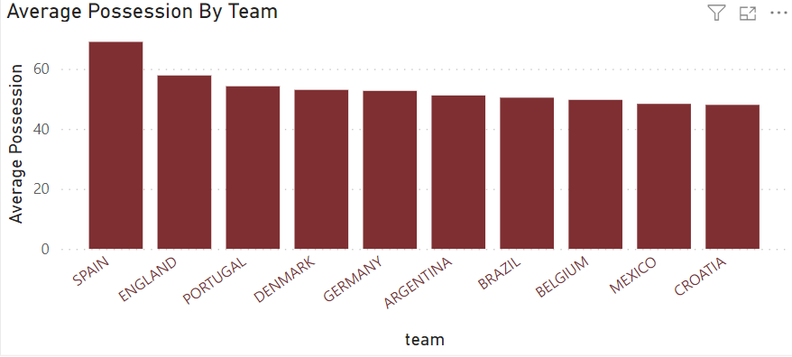
Analysis
(Average Possession by Top 10 Teams)
Visual
Analysis
To analyze this chart, we can look at the differences in possession percentages between the teams. Spain has the highest average possession percentage at 69%, followed by England at 57.8%, and Portugal at 54.2%. Croatia has the lowest average possession percentage at 48%.
We can also look at the difference in possession percentages between the top teams and the bottom teams. For example, the difference in possession percentage between Spain and Croatia is 21%. This suggests that Spain tends to dominate possession in their matches, while Croatia tends to have less possession.

Slide 7
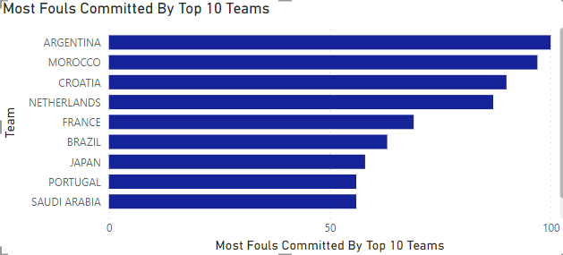
Most Fouls Committed by Top 10 Teams
Visual
Analysis
Argentina committed the highest number of fouls, with 100 fouls committed, followed closely by Morocco and Croatia. On the other end of the spectrum, England committed the least number of fouls, with only 53 fouls committed
It is important to note that several factors could influence the number of fouls committed, including the team's playing style, the nature of the game, and the level of aggression displayed by the opposing team
Ultimately, while the number of fouls committed could provide insight into a team's playing style and aggression, it does not necessarily correlate with a team's performance or success in a game.

Slide 8
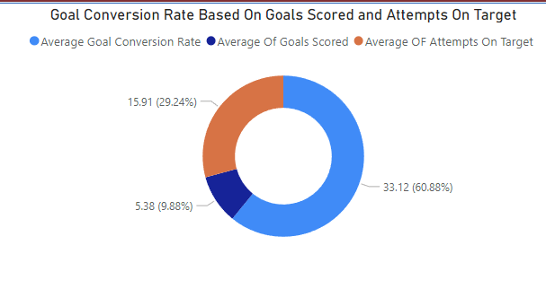
Goal Conversion Rate based on Goals Scored and Attempts on Target
Visual
Analysis
The data suggests that the teams in the tournament were relatively efficient in converting their attempts on target into goals, with a conversion rate of 33.12%. However, it is essential to note that this conversion rate may be influenced by several factors, including the quality of the opposing team's defense, the skill level of the players, and the nature of the game.
Furthermore, the average number of goals per team was 5.38, indicating that the teams were scoring an average of approximately five goals per tournament. This average may be impacted by the performance of individual teams, with some teams scoring more goals than others.
Finally, the average number of attempts on target per team was 15.91, which suggests that the teams were making an average of about 16 attempts on target per game. This average may also vary depending on several factors, including the style of play, the quality of the opposing team's defense, and the number of opportunities created by the team.
Overall, the data provides insight into the efficiency of teams in converting their attempts on target into goals, as well as the average number of goals and attempts on target per team.

Slide 9
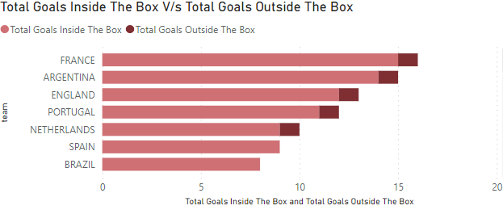
Total Goals Inside the Box V/s Outside the Box
Visual
Analysis
The table data shows the performance of each team in the tournament based on their goal conversion rate, total goals scored, and attempts on target. The Netherlands, Spain, and Serbia had the highest conversion rates, while Belgium had the lowest. Argentina scored the most goals, followed by Brazil and France, while the United States, Tunisia, and Qatar had the lowest number of goals. England had the highest number of attempts on target, followed by Argentina and Brazil.
These metrics provide valuable insights into each team's attacking prowess, but they should be considered in the context of the games they played, the quality of their opponents, and the style of play. For instance, a team that plays defensively and relies on counter-attacks may have a lower number of attempts on target, but a higher conversion rate. On the other hand, a team that dominates possession may have a higher number of attempts on target, but a lower conversion rate.

